Slide 1
REMOTE DATA INTEGRITY MONITORING WITH THE DESIGNATED VERIFIER WHILE IDENTITY BASED PRIVACY PRESERVED
NARMATHA P - 510619104051
RAJESHWARI R - 510619104055
SASI REKA A - 510619104061
Notes:
亲,更多同类作品,欢迎收藏不贰店铺:http://chn.docer.com/works?userid=14520189

Slide 2
Aim of the project
The aim of the project "Remote Data Integrity Monitoring with Designated Verifier while Identity-Based Privacy Preserved"
Is to develop a system that ensures the integrity of remote data while preserving the privacy of the data owner's identity.
Based on the IBC technology, we implement an RDPC scheme with a designated verifier,avoiding the problem of certificate management.
•
Our scheme achieves data privacy. The CSP uses a random integer to blind the data integrity proof, ensuring that the verifier does not obtain any data content.
•

Slide 3
ABSTRACT
Data privacy preserving is a technique to eliminate Privacy Preserving data in order.
To save storage space and enlarge upload bandwidth, which has been applied by cloud storage systems.
PoR to check the integrity of Privacy Perserving encrypted data, they ignore proving the correctness of duplication check during data upload and require the same file to be derived into same verification tags.So,we propose the verifiable duplication scheme.
We propose a novel Tag-flexible duplication-supported Integrity Check Protocol (TDICP) based on Private Information Retrieval (PIR) by introducing a novel verification tag .
To guarantee the correctness of data duplication check by introducing a novel User Determined Duplication Check Protocol (UDDCP) based on Private Set Intersection (PSI), which can resist a CSP from providing a fake duplication check result to user

Slide 4
OBJECTIVE
The main objectives of this project are to provide the facility to the data owner enforce fine-grained access control over data in large-scale data centers outsourced to Cloud Servers.
The key challenge in cloud is a Fine grained access control to improves the authentication based control the privacy intrusion detection for the cloud server.

Slide 5
INTRODUCTION
What is privacy preserving in cloud computing?
Privacy preserving in cloud environments includes two aspects: data processing security and data storage security. Data processing security covers the issues of how to protect user privacy at runtime in a virtualized cloud platform.
What is data integrity in cloud computing?
Data integrity in the cloud system means preserving information integrity. The data should not be lost or modified by unauthorized users.

Slide 6
LITERATURE SURVEY-1
Title: Mobiles on Cloud Nine: Efficient Task Migration Policies for Cloud Computing Systems.
Author: Lazaros Gkatzikis and Iordanis Koutsopoulos-Year: 2014
Description:
Due to limited processing and energy resources, mobile devices outsource their computationally intensive tasks to the cloud.
Clouds are shared facilities and hence task execution time may vary significantly.

Slide 7
ADVANTAGES
The elasticity of resource provisioning and the pay as- you-go pricing model.
Reducing the energy consumption of individual servers .
DISADVANTAGES
A strategy that does not consider migration cost and downloads time.
No migration.

Slide 8
LITERATURE SURVEY-2
Title: Privacy Protection and Data Security in Cloud Computing: A Survey, Challenges and Solutions
Author:Pan Jun Sun - Year: 2019
Description:
Privacy and security are the most important issues to the popularity of cloud computing service.Privacy protection based on accesscontrol, ﬁne-grained, trust and reputation ,CP-ABE (ciphertext policy attribute-based encryption) have been used.
To achieve ﬁne-grained security and privacyprotection in the process of dynamic data updating will be a major challenge.

Slide 9
ADVANTAGES
Simplified IT management and maintenance capabilities.
Enormous computing resources available on demand.
DISADVANTAGES
Still attackers are cheating in user privacy data,using CP-ABE algorithm.
Fine-grained access and privacy control is still in issue which is achieved further by some other algorithm like TDICP etc...

Slide 10
LITERATURE SURVEY-3
Title:Dominating Set and Network Coding-Based Routing in Wireless Mesh Networks.
Author: Jing Chen, Ruiying Du, year-2020.
Description:
Wireless mesh networks are widely applied in many fields such as industrial controlling,environmental monitoring, and military operations.
Network coding is promising technology that can improve the performance of wireless mesh networks.
It effectively deals with the coding collision problem of flows by introducing the information process, which effectively decreases the failure rate of decoding.

Slide 11
ADVANTAGES
Optimum combination of coding opportunity and coding validity.
Improve Network Performance.
DISADVANTAGES
Coding collision is a severe problem affecting network performance .
Increased pocket loss ratio.

Slide 12
LITERATURE SURVEY-4
Title:Privacy-Preserving Multi-Keyword Ranked Search over Encrypted Cloud Data.
Author: Ning Cao, Cong Wang, year-2020
Description:
Cloud computing is the long dreamed vision of computing as a utility, where cloud customers can remotely store their data into the cloud so as to enjoy the on-demand high-quality applications and services from a shared pool of configurable computing resources.
Its great flexibility and economic savings are motivating both individuals and enterprises to outsource their local complex data management system into the cloud.
To protect data privacy.

Slide 13
ADVANTAGES
Low overhead on computation and communication cost.
A ranked search mechanism to support extra search semantics and dynamic data operations.
It is more secure and efficient mechanism.
DISADVANTAGES
Single-keyword search without ranking.
Boolean- keyword search without ranking.

Slide 14
LITERATURE SURVEY-5
Title:SPOC: A Secure and Privacy-Preserving Opportunistic Computing Framework for Mobile-Data Integrity Emergency
Author:Rongxing Lu, Xiaodong Lin., Year-2021
Description:
Mobile Data Integrity (m-Data Integrity) system has been envisioned as an important application of computing to improve health care quality and save lives.
A opportunistic computing paradigm can be applied in m-Data Integrity emergency to resolve the challenging reliability issue in PHI process.
To propose a new secure and privacy preserving opportunistic computing framework, called SPOC to address this challenge

Slide 15
ADVANTAGES
Shift from a clinic-oriented, centralized Data Integrity system to a patient-oriented,distributed Data Integrity system.
Reduce Data Integrity expenses through more efficient use of clinical resources and earlier detection of medical conditions.
DISADVANTAGES
Performance, Reliability, Scalability, QoS, Privacy, Security.
More prone to failures, caused by power exhaustion, software and hardware faults, natural
Disasters, malicious attacks, and human errors etc.

Slide 16
EXISTING SYSTEM
Fail in supporting privacy preserving over verification tags. Introduced a new proof of storage scheme with duplication based on a publicly verifiable proof of data possession.
In their scheme, users can verify the correct storage of data with the key of the first user who actually uploads the file. However, this scheme has been proved insecure under a weak key attack and it cannot prevent the users from being cheated by the CSP.
Proposed a scheme by transforming the existing PoR into a form that is message-locked and integrating it with a duplication function and verification tags of it.

Slide 17
DISADVANTAGES IN EXISTING SYSTEM
An existing system can’t give solutions for the following issues.
.Cheating the data holders by providing a wrong duplication check result in order to ask a higher storage fee.
Causing data loss due to carelessness of data maintenance.
Snooping the private data of the data holders

Slide 18
PROPSED SYSTEM
The system proposes a novel protocol named TDICP based on PIR to check the integrity of uploaded files in the CSP with duplication employed. TDICP allows users to generate their own individual verification tags for integrity check.
The system proposes another novel protocol named UDDCP to guarantee the correctness of duplication check based on PSI, so that the CSP is impossible to cheat the user to pay for unused storage space due to duplication.
The system constructs a novel duplication scheme called remote data that contains the above two novel protocols and other essential properties, such as PoR and data access key assignment by re-shaping our previous scheme in order to overcome its shortcomings regarding integrity and duplication proof.

Slide 19
ADVANTAGES OF PROPOSED SYSTEM
Independent integrity check when duplication.
Correctness guarantee of duplication check.
Flexible tag generation

Slide 20
REQUIREMENTS
SOFTWARE REQUIREMENTS
Operating system - windows xp,7,8
Coding language - Java AWT,Swings,Networking
Database - MySql/Vs access
DC - Eclipse Gallileo
Development kit - JDK-5
HARDWARE REQUIREMENTS
System - core 3350z
Hard Disk - 250 GB
Monitor - color monitor
Mouse - optical mouse
Ram - 4GB

Slide 21
DESIGN METHODOLOGY
System Architecture

Slide 22
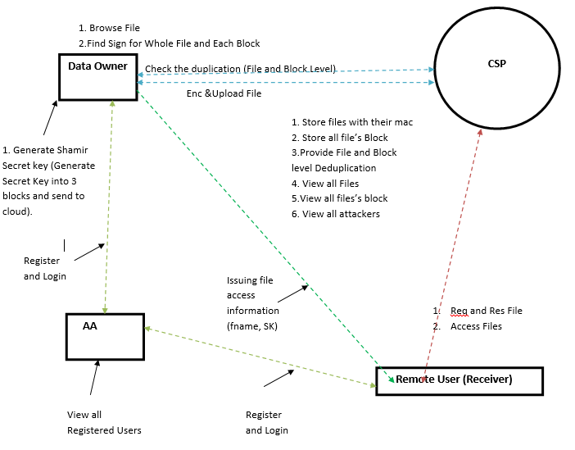

Slide 23
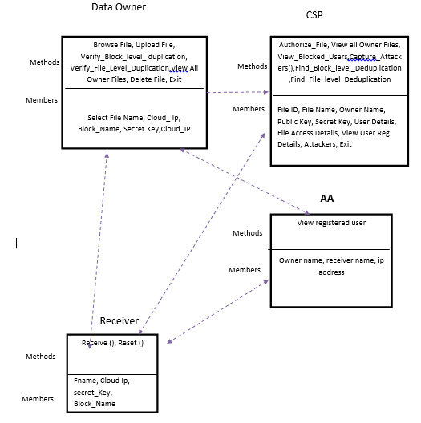
UML DIAGRAMS- Class Diagram

Slide 24
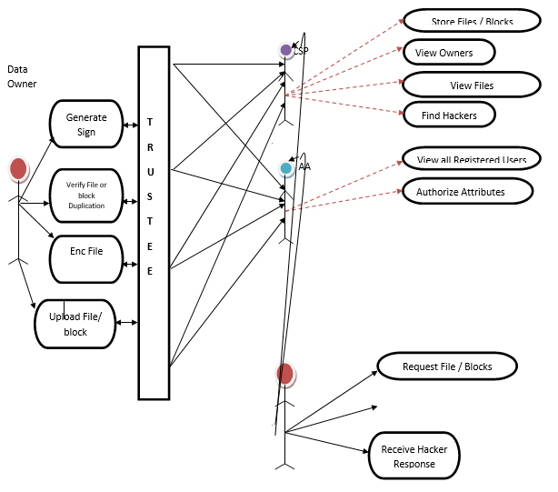
Use Case Diagrams

Slide 25
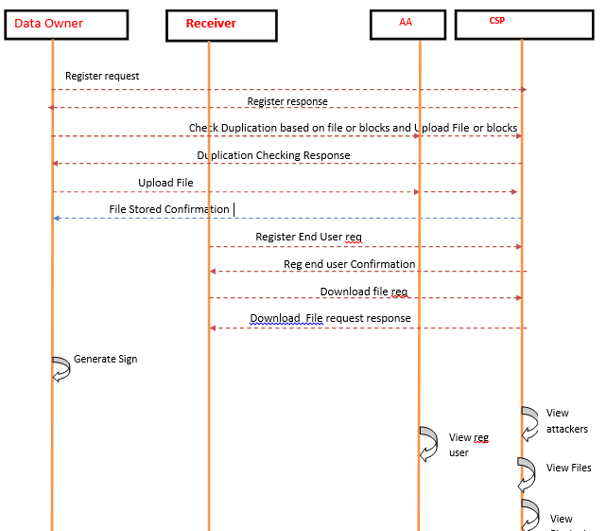
Sequence Diagrams

Slide 26
DataFlow Diagram
Level 1
Details
Uid
Admin
Login
Login_DB
Request
Uid
AssigTPA
TPA_DB
Files info
Files Details
Store
Files_DB

Slide 27
Level 2
Details
Uid
User
Register
Login_DB
Request
Login
Uid
Login_DB
Files info
Duplication Files
Upload Files
Files_DB
Request
View Files
Files_DB
File id
DownloadFiles
Files_DB

Slide 28
Level 3
Details
Uid
TPA_User
Register
Login_DB
Request
Login
Uid
Login_DB
Files info
Duplication Files
Verify Files
Files_DB
Remove Duplication N Files
Request
View Files
Files_DB
File id
Notify
Store
Files_DB

Slide 29
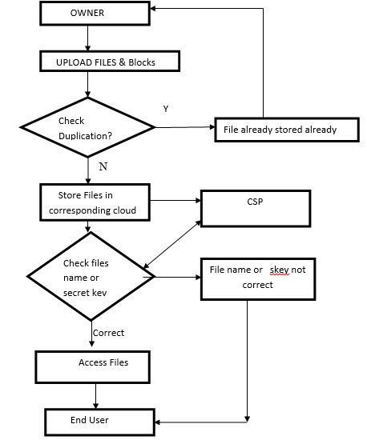
Flow Chart

Slide 30
Structure Chart
Privacy Security for Data integrity
Mastering file to cloud service provider
Chucking the file chosen
Dekey based Encryption
Hash value based decryption
Server
Encryption Data to cipher text
User Registration Phase
Download Request
File Splitting Process
Block Level Duplication
File Choose
Proof of Verification
File Tag Creation
Tagging each Split
Store in Rapid Storage
Cipher text download
Convergent Key
Decrypted to Original file
Key Sharing Mgt Cloud Server

Slide 31
LIST OF MODULES
Mastering File to Cloud Service Provide
Chunking the File Chosen
Dekey based Encryption
Hash Value Based Decryption
Data owner
Authentication Analyzer(AA)
Cloud Server
Remote User
Attacker Modules

Slide 32
Module Description
Mastering File to Cloud Service Provider
User is an entity which wants to outsource data storage to the storage cloud service provider (S-CSP) and access the data later
User registers to the cloud and logs in to it.
User chooses the file and uploads to server where the server store the file in rapid storage system.
File level de-duplication ischecked.
Administrator tags the file by using MD5 message.
Digest algorithm used is cryptographic hash function producing a 128-bit hash value.
Chunking the File Chosen
First, file chosen is broken into chunks of fixed size and generates tags for each of them.
After that it generates convergent keys for each blocks to verify block level deduplication
Then filename and password is provided for file authorization.
Encrypt the blocks by Triple Data Encryption Standard (3DES) algorithm.
The original content is encrypted as cipher text and stored in Storage Cloud Service Provider (S-CSP)
file storage system.

Slide 33
Dekey Based Encryption
After encryption the convergent keys are securely shared with Key Management
Cloud Service Provider (KMCSP)
Key management server checks duplicate copies of convergent keys in KMCSP.
Key Management Server maintains Comma Separated Values (CSV) file to check
proof of verification and store keys secure.
Hash Value Based Decryption
In the final model user requests for the downloading their own document which was uploaded earlier.
This download request needs proper ownership verification.
After verification, the original content is decrypted by requesting the cloud server.
The cloud server request key management server for keys to decrypt this and finally the original
content is received by the user.

Slide 34
Data Owner
In this module, the data owner uploads their data in the cloud server.
For the security purpose the data owner encrypts the data file and then store in the cloud.
The data owner can check the duplication of the file over Corresponding cloud server.
AA
In this module, the connector helps to check duplication of file
existed or not in cloud server and you can check in multi cloud servers also.
If it is existed then also owner trying to upload the same file in same
cloud server
then connector automatically blocks his access permission.
If it is not existed then data owner can upload file in multi
cloud servers at a time.

Slide 35
Cloud Server
The cloud service provider manages a cloud to provide data storage service.
Data owners encrypt their data files and store them in the cloud for sharing with Remote User.
To access the shared data files, data consumers download encrypted data files of their interest from
the cloud and then decrypt them.
Remote User
In this module, remote user logs in by using his user name and password.
After he will request for secrete key of required file from cloud servers, and get the secrete key.
After getting secrete key he is trying to download file by entering file name and secrete key from
cloud server.
Attacker Module
In remote user module, while downloading time if remote user entered any
wrong file name or secrete key then cloud servers treats him as attacker and moves his access
permission to block/attacker list.

Slide 36
Conclusion
Introduced VeriDeduplication to check the integrity of an outsourced encrypted file and guarantee the correctness of duplication check in an integrated way. The integrity check protocol TDICP of VeriDeduplication allows multiple data holders to verify the integrity of their outsourced file with their own individual verification tags without interacting with the data owner. On the other hand, we employed a novel challenge and response mechanism in the duplication check protocol UDDCP of VeriDeduplication to let the data holder instead of the CSP first tell whether a file is duplicate in order to guarantee the correctness of duplication check. Security and performance analysis show that VeriDeduplication is secure and efficient under the described security model. The result of our computer simulation further shows its efficiency compared with highly related prior arts.

Slide 37
FUTURE SCOPE
In the future, cloud storage vendors will focus on edge computing. While most people don't realize that their geographical decisions about the placement of cloud services are of utmost importance. The more cloud service infrastructure is used, the more expensive it will become cloud storage vendors will focus on edge computing. While most people don't realize that their geographical decisions about the placement of cloud services are of utmost importance. Further, the more cloud service infrastructure is used, the more expensive it will become.

Slide 38
References
1.Ahmadi Benjelloun.S, Kik M. E., T. Sharma, Chi.H, and Zhou.W,(2020)”Drug governance: IoT-based blockchain implementation in the pharmaceutical supply chain,&#39;&#39; in Proc. 6th Int. Conf. Mobile Secure Services
(MobiSecServ).
2. Batwa.A and Norrman.A, (2021),”Blockchain technology and trust in supply chain management: A literature review and research agenda”,&#39;Oper. Supply Chain Manage., Int. J., vol. 14, no. 2, pp.
3. Chang .S.E and Chen.Y, (2020)``When blockchain meets supply chain: Asystematic literature review on current development and potential applications,&#39;&#39; IEEE Access, vol. 8, pp. 62478_62494.
4. Dede.S, Köseo§lu.M.C, and Yercan.H.F, (2021)``Learning from early adopters of blockchain technology: A systematic review of supply chain case studies,&#39;&#39; Technol. Innov. Manage. Rev.

Slide 39
5. Gonczol.P, Katsikoul.P, Herskind.L, and Dragoni.N, (2020)``Blockchain implementations and use cases for supply chains_A survey,&#39;&#39; IEEEAccess,vol. 8, pp. 11856_11871.
6. Hackius.N and Petersen.M,(2020) ``Translating high hopes into tangible bene- _ts: How incumbents in supply chain and logistics approach blockchain,&#39;&#39; IEEE Access, vol. 8, pp. 34993_35003.
7. Hellani.H,Sliman.L, Samhat.A.E, and Exposito.E, (2021)``On blockchain integration with supply chain: Overview on data transparency,&#39;&#39; Logistics,vol. 5, no. 3, p. 46.
8. Kummer.S, Herold D. M.,Dobrovnik.M and Schäfer.N, (2020)``Asystematic review of blockchain literature in logistics and supply chain management: Identifying research questions and future directions,&#39;&#39; FutureInternet, vol. 12, no. 3, p. 60.

Slide 40
THANK YOU

